Slide 1
Los Medicos Voladores
Medical Assisting Class

Slide 2
OUTLINE
Patient care
Record Keeping
Temperature Taking
Blood Pressure
Diabetes Testing
Pulse

Slide 3
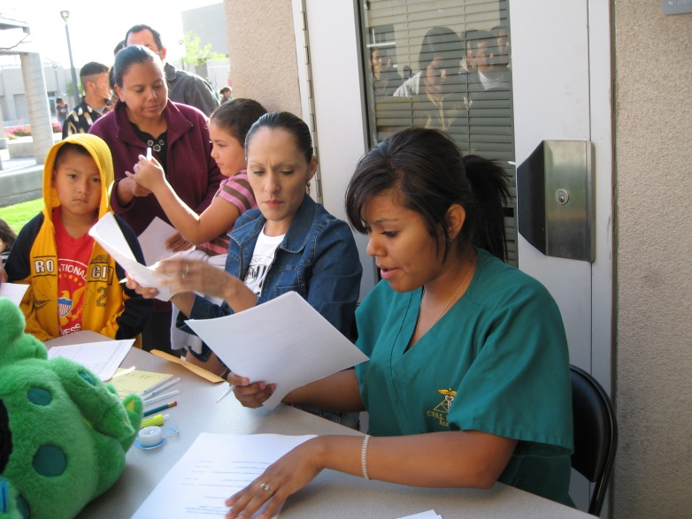
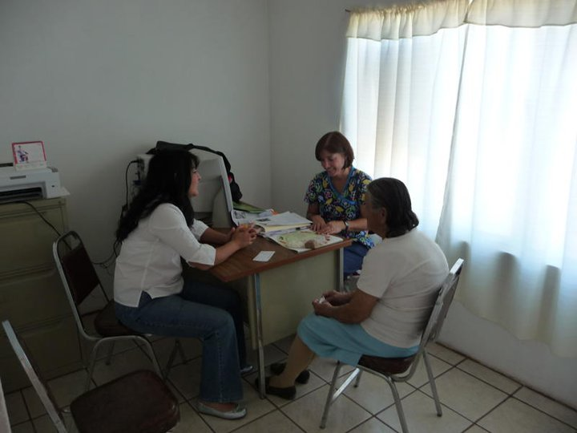
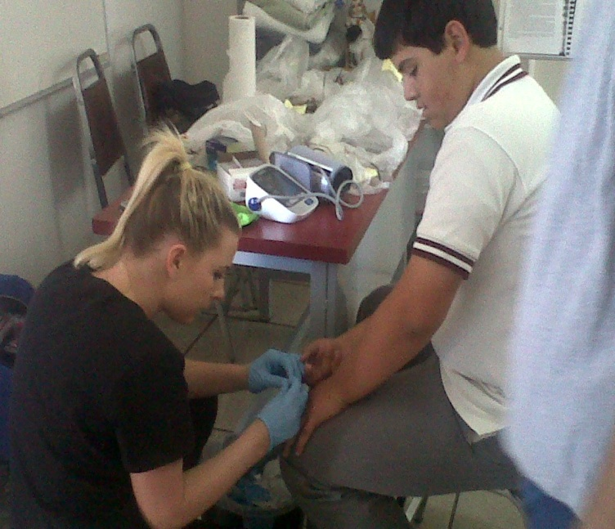
Medical Assistant Procedure

Slide 4
Dr. Morgan’s Patient Care
Look patient over and carefully think about what may be a problem not mentioned. If any problem surfaces, write it on the chart.
Give the patient encouragement, positive attention, or sympathetic reaction to his/her comments.
Tell the patient he/she is "number 4" to see the doctor and that he/she will be seen soon.

Slide 5
Patient Care (continued)
With all of this information on the patient's chart, let the Dr. know what is happening. (This approach makes the visit shorter; therefore more people can be seen.)
Introduce the patient to the doctor.
After patient is finished, say something positive,
such as, “The best to you."

Slide 6
Record Keeping
On the patient's chart; Full name, birth date, address, phone number, chief complaint number 1 and 2.
Next ask, "What medications do you take? What ones do you have on hand? What do you need a new RX for?“
Patient information; height and weight is important, even an estimate.

Slide 7
Patient History

Slide 8
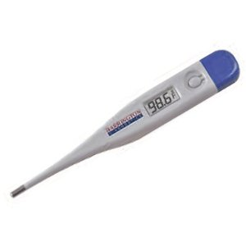
Temperature Taking
Normal body temperature is about 98.6 degrees Fahrenheit (°F) or 37 degrees Celsius (°C). Your temperature often varies from 1 to 2 °F or ½ to 1 °C. Your temperature is usually lower in the morning and increases during the day. It reaches its high in the late afternoon or evening.

Slide 9
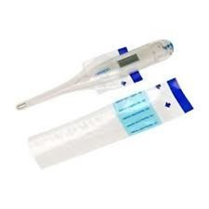
Taking Temperature with a Digital Thermometer
Use a clean thermometer,
Insert thermometer into plastic protective cover.
Peel off the blue protective cover. Remove the backing paper.
Place the thermometer tip under the patients tongue.
Hold the thermometer in the same spot for 40 seconds.
Readings will continue to increase and the F (or C) symbol will flash during measurement.
The thermometer will make a beeping noise when the final reading is done. Record the temperature and the time.
Because teeth may penetrate the probe
cover, clean thermometer with alcohol.

Slide 10
Taking Pulse

Slide 11
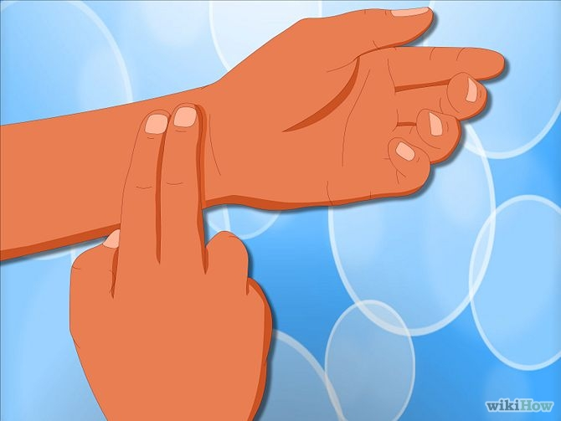
Use your fingers.
Don't use your thumb, as it has its own pulse. Find the radial pulse. This is also known as the pulse on the inside of the wrist. Use the pads of two fingers. Place these just below the wrist creases at the base of the thumb. Press lightly until you feel a pulse (blood pulsing under your fingers). If necessary, move fingers around until you feel the pulse.

Slide 12
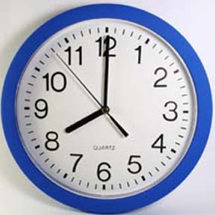
Check and Record Heart Rate.
Use a watch or clock with a second hand. Make a note of the rate of the pulse, which is the number of beats per minute.

Slide 13
Determine the Normal Heart Rate.
For adults, normal heart rate is 60-100 beats per minute. For children under age 18, normal heart rate is 70-100 beats per minute. This is the heart rate at rest.
You can determine heart rate by counting pulse for 15 seconds and multiplying that number by 4.

Slide 14
Check the Strength of the Pulse
The pulse's strength cannot be calculated. While feeling pulse, you should decide whether the pulse is:
"weak“
"faint“
"strong”
"bounding".

Slide 15
Check the Rhythm of the Pulse.
This is a measurement of the heart's pulsations and the pauses between them. If the pulse is steady, it should be marked as regular. If you detect a skip or other oddity about the pulse, it may be irregular.

Slide 16
What To Do If You Can't Find Pulse

Slide 17
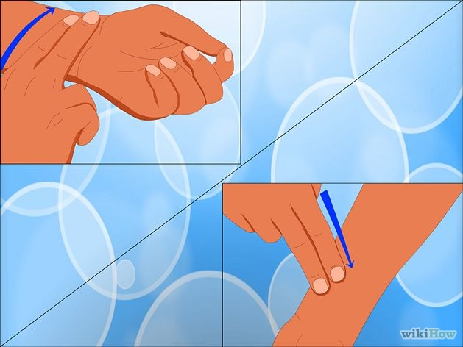
Try Using Fingertips Instead of Laying Fingers Across the Wrist.
Place fingertips in different places and stop in each location for five seconds.

Slide 18
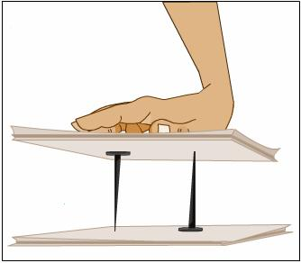
Try Varying the Pressure of your Fingertips on the Wrist.
Sometimes lightening your touch or pressing harder will help you find the pulse.

Slide 19
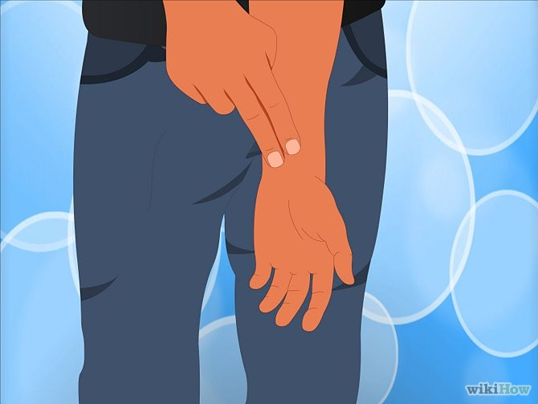
Try Pointing the Arm at the Floor.
The change in blood flow may help you find the pulse.

Slide 20
Taking Blood Pressure with a Sphygmomanometer

Slide 21
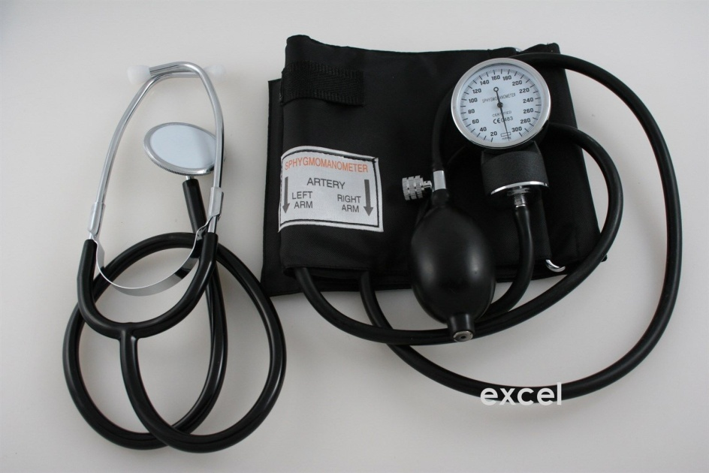
Setting Up the Equipment
Sit down at a table or desk where you can easily set up the necessary equipment.
Remove the cuff, stethoscope, pressure gauge, and bulb (also known as a "bladder") from the kit, taking care to untangle the various tubes.

Slide 22
Raise Arm to Heart Level.
Elevate the arm so that the bent elbow is parallel to the heart. This ensures that you will not get either an overestimated or an underestimated blood pressure reading. It is also important that the arm is supported during the reading, so make
sure to rest the elbow on
a stable surface.

Slide 23
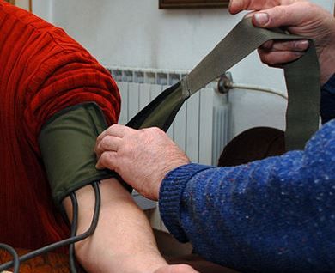
Wrap the Cuff around the Upper Arm.
Most cuffs have Velcro, making it easy to secure the cuff in place. If the shirt has long sleeves, roll them up first. The bottom edge of the cuff should be about an inch above the elbow. Some experts recommend you use the left arm; others suggest you test both arms.

Slide 24
Make sure the Cuff is Snug, but not too tight.
If the cuff is too loose, it will not cut off the artery correctly, giving you an inaccurately low blood pressure reading. If the cuff is too tight, it will create what is known as "cuff hypertension" and give you an inaccurately high reading.

Slide 25
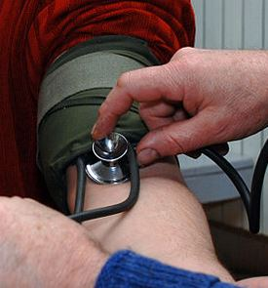
Place the Wide Head of the Stethoscope on Arm.
The head of the stethoscope (also known as the diaphragm) should be placed flat against the skin on the inside of patients arm. The edge of the diaphragm should be just beneath the cuff, positioned over the brachial artery. Gently put the earpieces of the stethoscope in your ears. Do not hold the head of the stethoscope with your thumb - your thumb has its own pulse and this will confuse you while you try to obtain a reading.
A good method is to hold the head of
the stethoscope in place with your
index and middle fingers. This way,
you should not hear a thumping
sound until you have begun to
inflate the cuff.

Slide 26
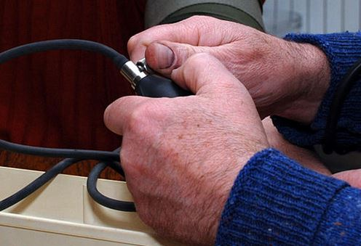
Take the Rubber Bulb and Tighten the Valve.
The valve needs to be closed completely before you start. This will ensure that no air escapes as you pump, which would produce an inaccurate reading. Twist the valve clockwise, until you feel it stop. It is also important to avoid
over-tightening the
valve, otherwise
you will open it too
far and release the
air too quickly.

Slide 27
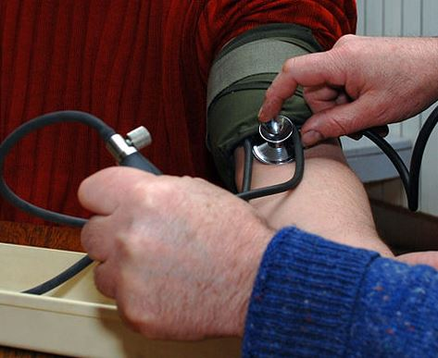
Inflate the Cuff.
Rapidly pump the bulb to inflate the cuff. Keep pumping until the needle on the gauge reaches 180mmHg. The pressure from the cuff will occlude a large artery in the bicep, temporarily cutting off blood flow. This is why the pressure
from the cuff can
feel a little
uncomfortable or
strange.

Slide 28
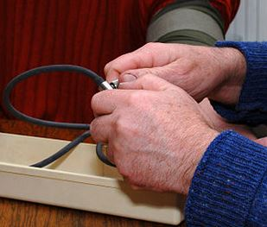
Release the Valve
Gently turn the valve on the bulb counter-clockwise, so that the air in the cuff is released steadily, at a moderate pace. Keep an eye on the gauge; for best accuracy, the needle should be moving downwards at a rate of 3mm per second. Releasing the valve while you hold the stethoscope can be a little tricky. Try releasing the valve with the hand on
your cuff arm, while holding
the stethoscope with your
free arm.

Slide 29
Note the Systolic Blood Pressure.
As the pressure drops, use the stethoscope to listen for a thumping or knocking sound. When you hear the first thump, make a note of the pressure on the gauge. This is the systolic blood pressure. The systolic number represents the pressure your blood flow exerts on the walls of an artery after the heart beats or contracts. It is the higher number of the two blood pressure readings, and when blood pressure is written down, it appears at the top.
The clinical name for the thumping sounds your hear is "Korotkoff sounds".

Slide 30
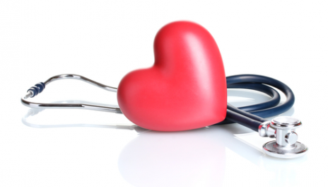
Note the Diastolic Blood Pressure.
Keep watching the gauge, while using the stethoscope to listen to the thumping noises. Eventually the hard thumping noises will turn into a "whooshing" sound. It is helpful to note this change, as it indicates that you are close to your diastolic blood pressure. As soon as the whooshing noise subsides, and you hear only silence, make a note of the pressure on the gauge. This is the diastolic blood pressure. The diastolic number represents the pressure the blood flow exerts on the walls of an artery when the heart relaxes between contractions. It is the lower number of the two blood pressure readings, and when blood pressure is written down, it appears at the bottom.

Slide 31
Understand What the Readings Mean.
Once you have recorded the blood pressure, it is important to know what the numbers mean. Use the following guide for reference:
Normal blood pressure: Systolic number of less than 120 and diastolic number of less than 80.
Prehypertension: Systolic number between 120 and 139, diastolic number between 80 and 89.
Stage 1 Hypertension: Systolic number between 140 and 159, diastolic number between 90 and 99.
Stage 2 Hypertension: Systolic number higher than 160 and diastolic number higher than 100.
Hypertensive Crisis: Systolic number higher than 180 and diastolic number higher than 110.^{[5]}

Slide 32
Don't Worry if BP is Low.
Even if blood pressure readings are far below the 120/80 "normal" mark, there is no cause for concern. A low blood pressure reading of, say, 85/55 is still considered to be normal, as long as no symptoms of low blood pressure are present.
If the patient is experiencing symptoms of dizziness, lightheadedness, dehydration, nausea, blurred vision and/or fatigue, notify the doctor immediately.

Slide 33
Blood Pressure Testing

Slide 34
Blood Pressure Testing

Slide 35
Patient History

Slide 36
Diabetes Testing

Slide 37
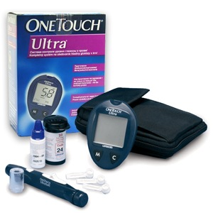
Diabetes Testing
Check the patients glucose levels if:
Any Diabetes is in the family
If the patient is Diabetic
If the patient requests it
If the Dr. requests it.

Slide 38
Supplies You Will Use
Blood Glucose Meter — reads blood sugar.
Test Strip — collects blood sample.
Lancet — fits into lancing device, pricks finger, and provides small drop of blood for glucose strip.
Lancing Device — punctures finger when button is pressed.
Alcohol Wipes — to clean fingers.
User Manual — provides information about your meter.

Slide 39
Test Glucose Meter
Before you start, insert the a strip into the meter. If the time in the lower right hand corner blinks, cycle through the date and time by pressing the left hand M button 6 times.
Reinsert the test strip. If there are 3 dashes, then you must program the test strip code number found on the bottle, by pressing the C button, until you find the number.
A blood drop symbol will appear and you can start the test.

Slide 40
Testing
Clean test site
Insert the test strip into the blood glucose meter.
Puncture the site with a lancing device.
Put a little drop of blood on the test strip.
In seconds, the blood glucose meter reads blood sugar level.

Slide 41
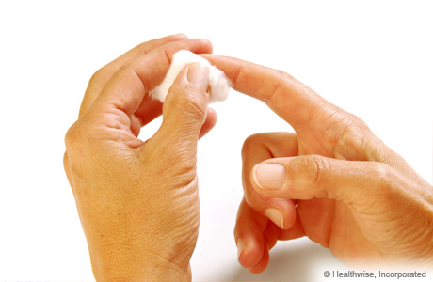
Clean Test Site
Clean patients finger with alcohol. If you are using alcohol, let it dry before you puncture finger.

Slide 42
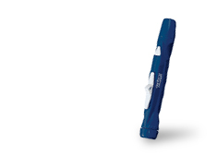
Puncture the Site with a Lancing Device

Slide 43
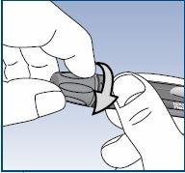
Step 1
Remove the blue cap of the Adjustable Blood Sampler by twisting it off

Slide 44
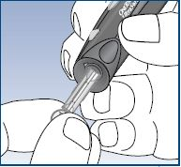
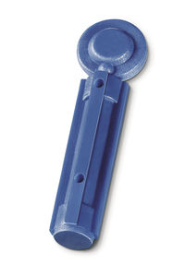
Step 2
Insert the lancet into the holder and push in firmly. Twist the protective disk until it separates from the lancet and save the disk for later use. Do not twist the lancet.

Slide 45
Step 3
Replace the blue cap by twisting it back on until it is snug.

Slide 46
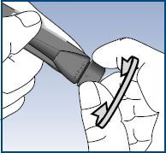
Step 4
Adjust the Depth Setting
Start with the medium setting.
If necessary, twist the depth adjustment knob toward the smaller dots on the Adjustable Blood Sampler for a shallow puncture or toward the larger dots for a deeper puncture.

Slide 47
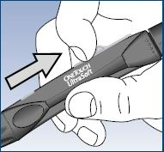
Step 5
Slide the control button back until it clicks.

Slide 48
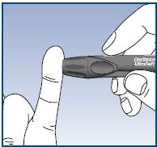
Step 6
Hold the Adjustable Blood Sampler firmly against the side of the patients pinkie finger.
Press the release button.

Slide 49
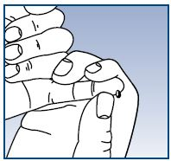
Step 7
Gently squeeze or massage fingertip until a round drop of blood forms on the fingertip.
If the blood smears or runs, do not use that sample. Dry the area and gently squeeze another drop of blood or puncture a new site.

Slide 50
Determine Glucose Level

Slide 51
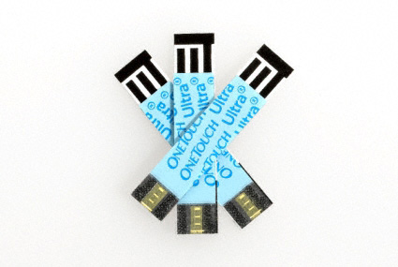
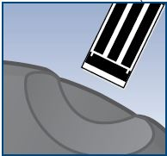
Insert a Test Strip
Start with the meter off. Remove a test strip from its vial. With clean, dry hands, you may touch the test strip anywhere on its surface.
Insert the test strip into the test port. Make sure the 3 contact bars are facing you. Push the test strip in as far as it
will go. Do not bend the
test strip.

Slide 52
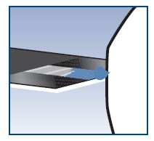
Apply the Sample
Line up the test strip with the blood drop so that the narrow channel on the edge of the test strip is almost touching the edge of the blood drop.
Gently touch the channel to the edge of the blood drop.
Be careful not to push the test strip against the fingertip or the test strip may not fill completely.
Results will appear almost
immediately.

Slide 53
Record Results
The American Association for Clinical Endocrinologists recommends the following targets for blood sugar:
Fasting Glucose: < 110 mg/dL
2 Hour Postprandial (after you eat): <140 mg/dL

Slide 54
Dr. Morgan’s recommendations

Slide 55
Be Prepared

Slide 56
Each Medical Assistant Should Have Their Own
Patient History Forms
Stethoscope
Blood Pressure Cuff
Hand cleanser spray or lotion
Surgery gloves
Face mask
Several tiny packets of alcohol sponges
Scrubs

Slide 57
The Dr.’s Equipment
The doctor should bring any and all of the special equipment she or he may commonly use in general practice. These might be spread out on fresh paper or cloth or they might prefer to keep things in their bag until used. The doctor should have tongue blades and use the otoscope light to look in a patient’s mouth, ophthalmoscope, plus other things they commonly use, like paper temperature gauges, maybe even a small surgery kit.
The Dr. may need--tongue blades,
flash light, Surgery gloves, RX pad,
mask, stethoscope, blood pressure
cuff, alcohol sponges, and wound
care supplies.

Slide 58
Finally
The Doctor should bring everything they need.
Medical supply kits for the assistant can be created using supplies found in the storage unit. Contact a board member prior to your trip to get a kit.

